Slide 1
Seek Job Advertisement Assistant Agent
2025-10-27 by Xiaoshi Lu (Alexandra)

Slide 2
Table of Contents
1. Business Background and Scope | ___________________________________________ 03
2. Data Sources and Analysis | ___________________________________________ 06
3. Agent Design and Settings | ___________________________________________ 10
4. Demo and Outputs | ___________________________________________ 15
5. Further Improvements and Plans | ___________________________________________ 18
6. Resources | ___________________________________________ 20
7. Conclusion and Questions | ___________________________________________ 22

Slide 3
Business Background and Scope

Slide 4
Both employers and job seekers need assistance for job advertisement on Seek.
There are around 16k ~ 20k job advertisements on Seek. Every months there are millions of visits from employers / recruiters and job seekers.
Job advertisements are the base of resources that support the service of Seek, especially the recommendation system for both sides of customers to improve their customer experience.
However, in reality, many job advertisements or job seek profiles are vague, incomplete, or inconcise, which creates challenges for Seek customers.
With the cutting-edge techniques such as LLMs and Agentic AI building, there is an opportunity to explore the headroom to help customers with intelligent assistant.
Reference: Seek Employment Report 2025 September

Slide 5
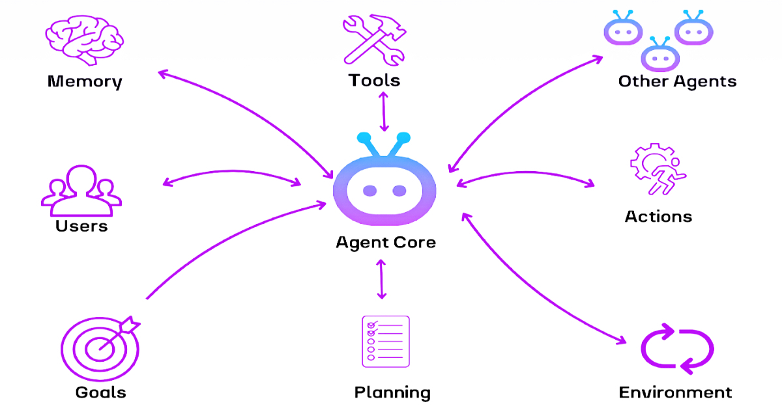
Using AI to improve job advertisement content analysis is the starting point to improve recommendation system.
Job advertisements usually provide key information including required skills, expected responsibilities, and other requirements.
  Agentic AI with LLMs can provide more proactive solutions to solve the problem.
The outputs for the above project can support the building of the whole recommendation system, especially the downstream parts:
  Help employers improve job advertisements.
  Help job seeks to find the suitable opportunities.
Image Reference: Coders Brain: How Does Agentic AI Work?

Slide 6
Data Sources and Analysis

Slide 7
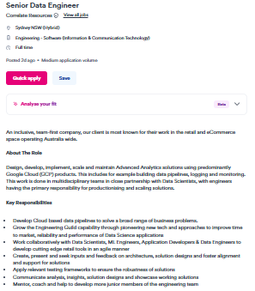
The 50k job advertisements in the database are already structured.
Job Title
Metadata
Classification, Sub-classification, Area, Location, and Work Type, etc.
Detailed description of required skills and responsibilities.
Content
Image Reference: Senior Data Scientist

Slide 8
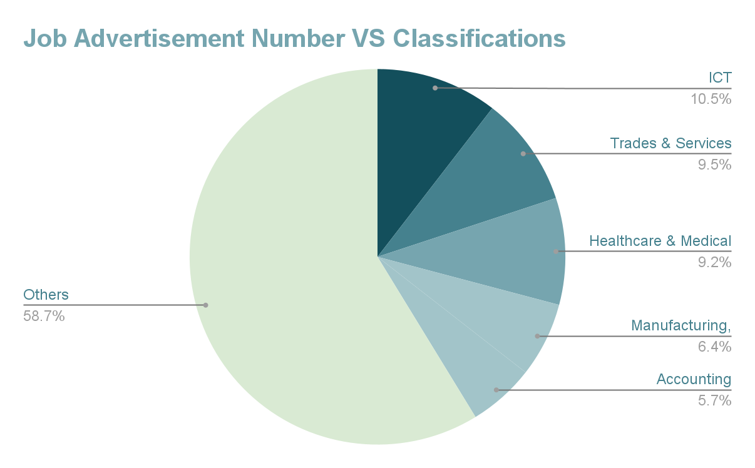
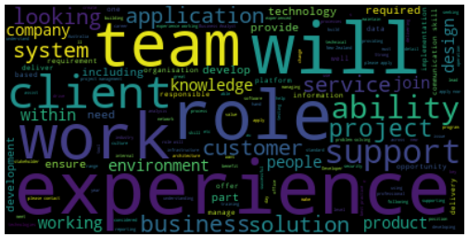
After preprocessing and EDA, there are 30 classifications/industries. Each has different popular key words.
Information & Communication Technology Word Cloud
For future scalability, classification is a good variable to divide resources.

Slide 9
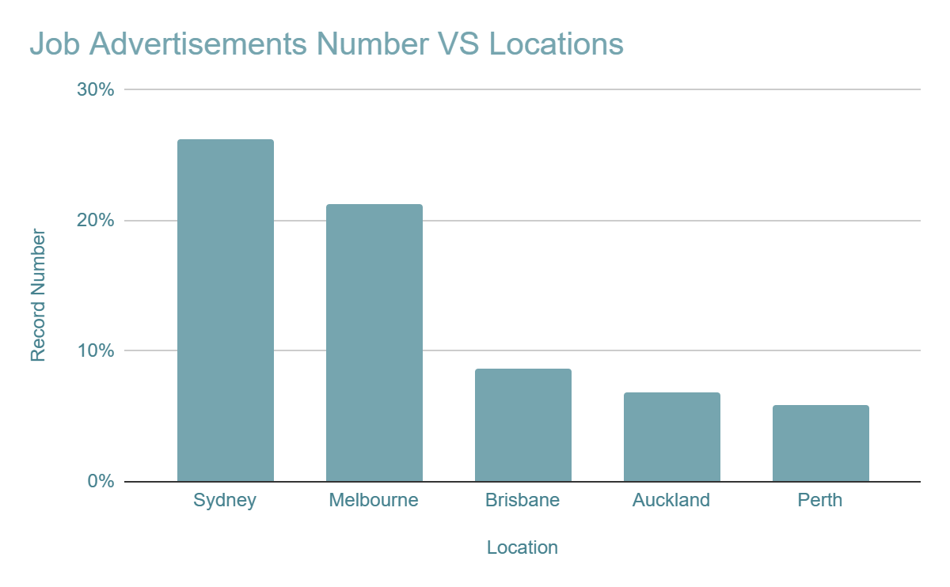
The overwhelming majority of the jobs locates in Australia and New Zealand.
Accordingly, English is the most popular job advertisement language.
  However, there are still few job advertisements from Middle East & Asia, Europe & Russia with non-English languages.
70% of jobs are full-time opportunities.

Slide 10
Agent Design and Settings

Slide 11
Build datasets based on given job advertisements for both training and validation.
The testing data will be separated during the early development stage.
In future, it can be manually labelled to create a golden dataset.
It will be valuable to prove the RoI of AI products.
It is good to create a testing dataset where each classification has some samples based on the original percentage. (stratified sampling)
However, in this use case, we temporarily use typical random train-test splitting to save time.
Training data
Testing data

Slide 12
The following tools are used to build AI assistant for job advertisement analysis and consumption.
Language Models: GPT family
– popular, good performance.
Frameworks: LangChain + LangGraph
– compatible, open-source, memory and thread management, conditional control.
Vector Store: ChromaDB
– Cheap, light-weight, good for local development, compatible with cloud environment.
Orchestration: LangFuse
– Transparent tracing.
Evaluation and Metrics:
Cost and Time
ROUGE and Bert Score
Customised Metrics

Slide 13
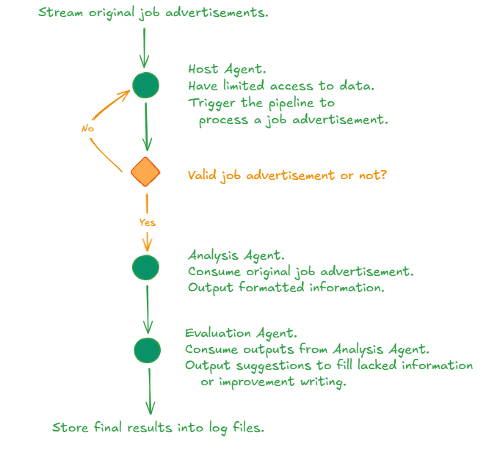
AI workflow design consists of 2 pipelines with prompt engineering and RAG techniques.
Key features:
It streams job advertisement from dataset.
It uses control edge to process invalid requests.
It uses prompt engineering to reduce hallucination and ensure output format.
It builds local log files and datasets to store information.
It controls workflow historical records by windows sliding.

Slide 14
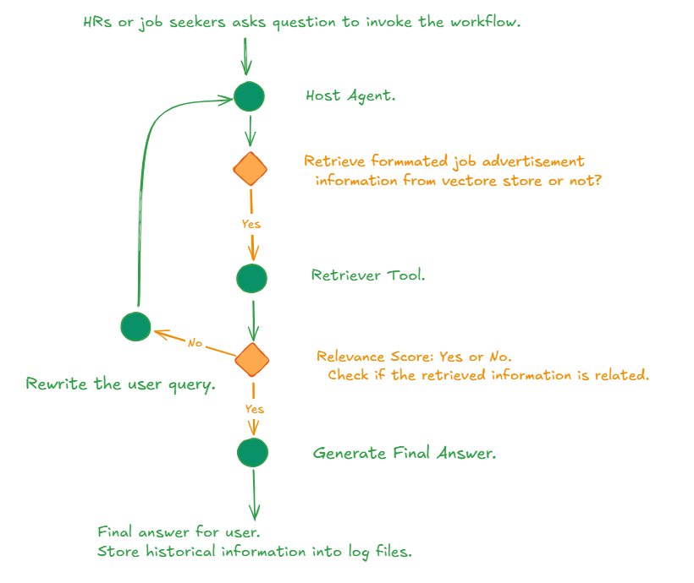
The outputs from job advertisement analysis can help with customers with huge flexibility.
Key features:
It uses prompt engineering + RAG to reduce hallucination and uses pydantic tool to ensure output format in some specific steps.
It builds local logs and datasets to store information.
It uses another LLM based agent to evaluate the retrieving quality.

Slide 15
Demo and Outputs

Slide 16
The sample outputs of both pipeline are as follows.
Job Advertisement Analysis
Job title, skills, responsibilities, requirements, classification, salary, location, and work type
The evaluation and suggestions of above information
Workflow invoke time and thread id – for version management
Client Assistant
User’s question
Final answer
Workflow invoke time and thread id – for version management
Retrieving tool calling number and Rewriting user’s question number – for customised metric

Slide 17
There are 3 groups of metrics to evaluate the AI workflows.
LangFuse Tracing
Cost per job advertisement analysis: ~ 0.03 AUD.
Time consumption per job advertisement analysis: ~ 12 seconds.
Accuracy
Bert Score for semantic accuracy and meaning
  how generated analysis is semantically similar to the original one 0.73 (precision)
  how original advertisements are captured by generated analysis 0.59 (recall)
ROUGE for word-Level similarity
  Combined results: 0.65 (F1)
Customised Retrieval Quality 0.50
  Defined as the number of good retrieve calling evaluated by agent / the number of retrieval tool calling

Slide 18
Further Improvements and Plans

Slide 19
Considering future scalability, there are some steps we can further explore.
Classification-specific job analysis
Currently the AI workflow relied on LLM’s ability to deal with all job advertisements.
In future, the job advertisements can be divided based on their classification, and the workflow can be horizontally expanded and process different classifications in parallel, which can improve the quality and reduct time consumptions.
Language
Currently the assumption is most of the advertisements are English.
In future, with prompt engineering or further agent setting, the workflow can deal with multi-language.
Design and evaluation
Build the golden dataset for validation and testing.
Add refreshment function for vector store with version control.
More user-friendly UI.

Slide 20
Resources

Slide 21
Useful links are attached.
GitHub Repository
Google Sheet with Charts

Slide 22
Thanks a lot for Watching!

Slide 23
The deck will be shared offline. Please list any questions and concerns in the following part. We will answer them!
TBC.

